Slide 1
SHWETHA B
FINAL PROJECT

Slide 2
PROJECT TITLE
IMAGE GENERATION USING GENERATIVE ADVERSARIAL NETWORK
DEPARTMENT OF COMPUTER SCIENCE AND ENGINEERING
PRESENTED BY : B SHWETHA
REGISTER NUMBER : 813821104093
NM ID : shwethabaskar23022004@gmail.com
(au813821104093)

Slide 3


AGENDA
Introduction to GANs
Overview and components of Generative Adversarial Networks (GANs).
Understanding Image Generation with GANs
Intuition behind GAN-based image generation and its applications.
Review of Relevant Research
Survey recent advancements in GAN-based image generation techniques.
Preparation of Datasets
Selection and preprocessing of datasets for training.
Implementation of GAN Architecture
Choosing a GAN architecture and setting up generator and discriminator networks.
Training the GAN
Configuring training parameters and monitoring progress.
Evaluation and Fine-Tuning
Qualitative and quantitative evaluation of generated images.
Advanced Techniques and Considerations
Exploring advanced techniques and addressing ethical implications.
Application and Deployment
Integrating the model into applications and considering deployment strategies.
Conclusion and Future Directions
Summarizing findings and outlining future research directions.
3/21/2024 Annual Review

Slide 4

PROBLEM STATEMENT
Develop a GAN-based solution to generate realistic images similar to those found in the CIFAR-10 dataset. The goal is to train a model capable of generating high-quality images that closely resemble the characteristics of the CIFAR-10 dataset, such as various objects and scenes with realistic textures and colors.

Slide 5

PROJECT OVERVIEW
This project implements a Generative Adversarial Network (GAN) to generate realistic images resembling those in the CIFAR-10 dataset.
It consists of a discriminator network to distinguish real from fake images and a generator network to produce synthetic images.
Through adversarial training, the generator learns to create images that fool the discriminator, resulting in high-quality outputs.
The training process iteratively refines both networks, aiming to produce diverse and visually appealing images.
Ultimately, the project aims to demonstrate the effectiveness of GANs in generating lifelike images for various applications.

Slide 6

WHO ARE THE END USERS?
Artificial Intelligence Researchers: Researchers in the field of artificial intelligence, specifically in computer vision and generative modeling, could utilize this model for further experimentation, benchmarking, and advancements in GAN technology.
Data Scientists: Data scientists interested in image generation, data augmentation, or synthetic data generation tasks could leverage this model to generate realistic images for training machine learning models in various domains.
Content Creators: Artists, designers, and creators looking for high-quality synthetic images for creative projects, digital art, or visual content creation could benefit from using this model to generate diverse and visually appealing images.
Developers: Software developers interested in integrating image generation capabilities into applications, such as virtual environments, gaming, or graphic design tools, could incorporate this model to provide users with realistic image synthesis functionality.

Slide 7

YOUR SOLUTION AND ITS VALUE PROPOSITION
Realistic Image Generation
Cost-Effective Data Augmentation
Creative Exploration
Streamlined Development
Research Advancement

Slide 8

THE WOW IN YOUR SOLUTION
The "wow" factor lies in the model's capacity to autonomously generate highly realistic images akin to those in the CIFAR-10 dataset, offering cost-effective data augmentation, fostering creative exploration, streamlining development workflows, and propelling advancements in research.
3/21/2024 Annual Review

Slide 9
MODELLING
Generative Adversarial Network (GAN)
A Generative Adversarial Network (GAN) is a deep learning framework consisting of two neural networks, the generator and discriminator, engaged in an adversarial training process. The generator learns to produce synthetic data resembling real data samples, while the discriminator learns to distinguish between real and fake data. Through adversarial training, GANs generate realistic outputs and have applications in image generation, data synthesis, and other fields

Slide 10
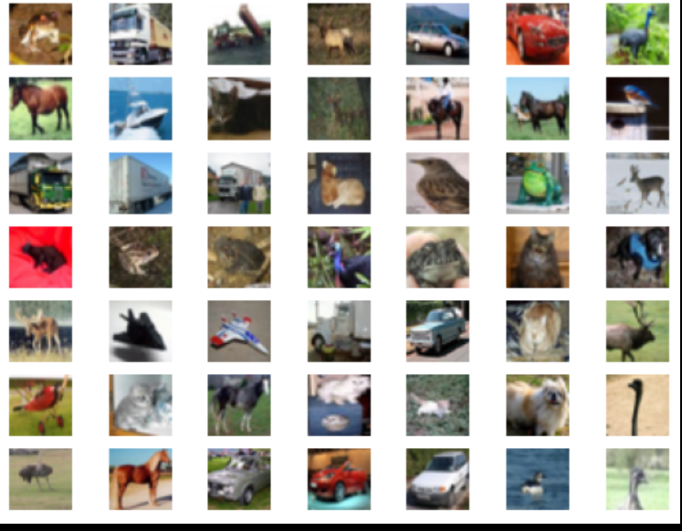
RESULTS
Demo Link

Slide 11
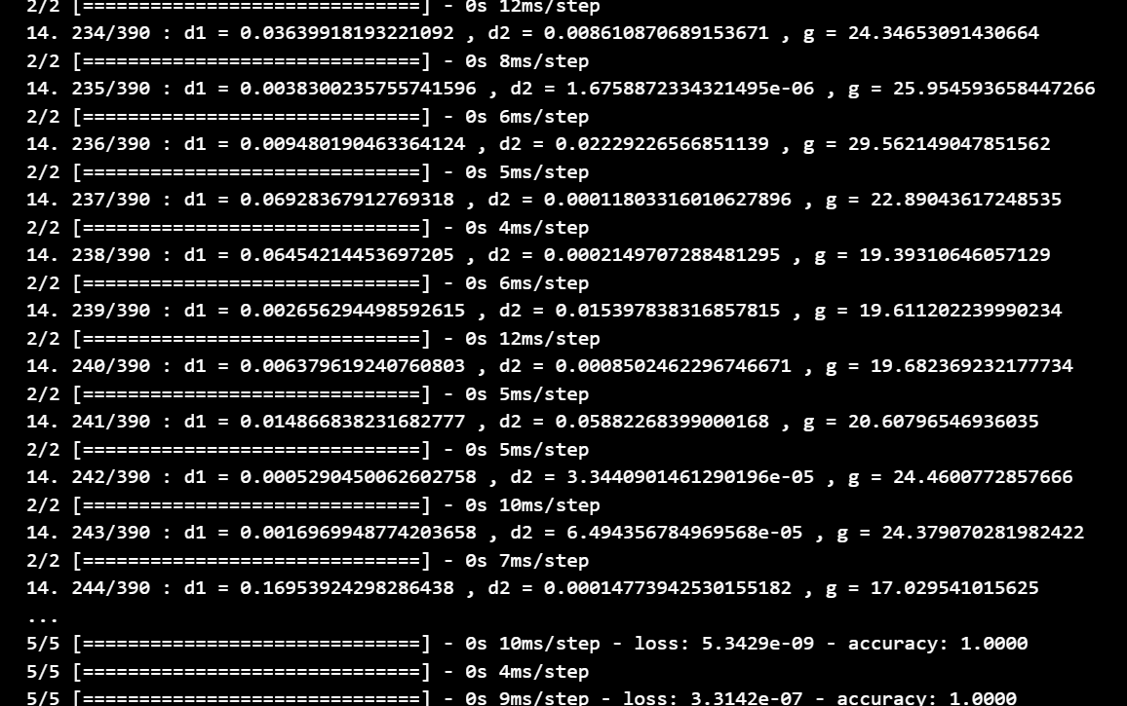
RESULTS
Demo Link

